Slide 1
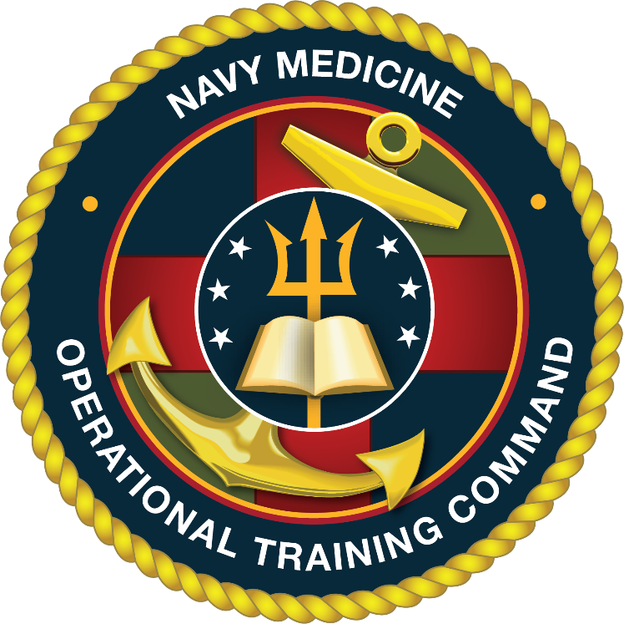
Navy Medicine Operational
Training COMMAND
COMMAND BRIEF

Slide 2
Mission
Provide Operational Medical and Aviation Survival Training
Vision
Recognized as the global leader in operational medical training, innovative and responsive to the challenges of the warfighter
23,000 personnel trained annually,
the largest training throughput in Navy Medicine!
https://www.med.navy.mil/sites/nmotc/Pages/default.aspx
Readiness, Relevance, Relationships

Slide 3
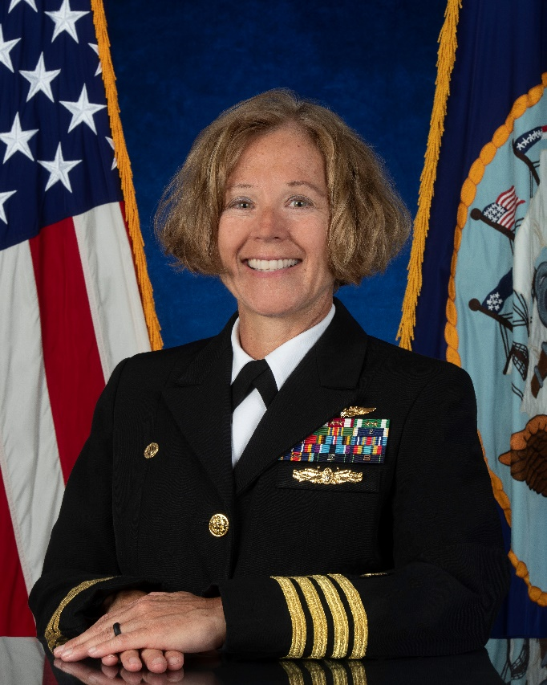
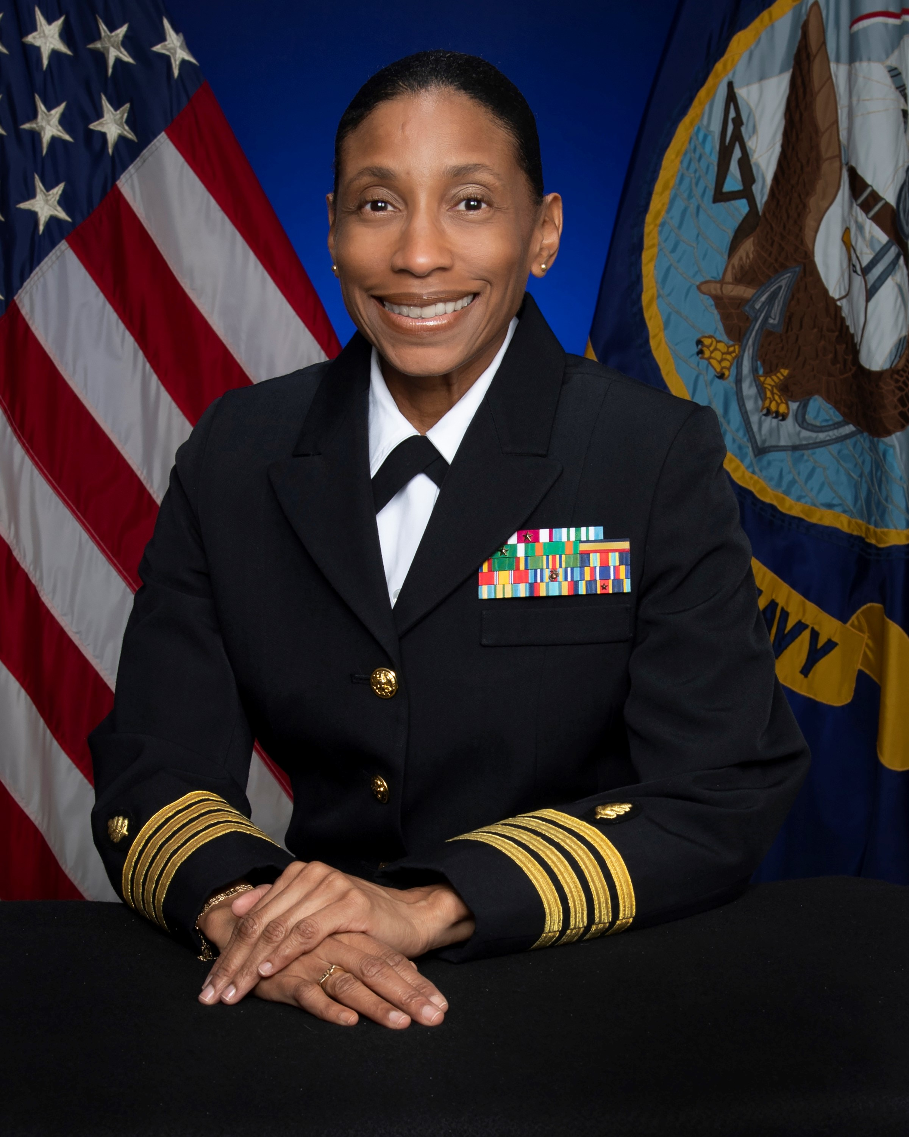
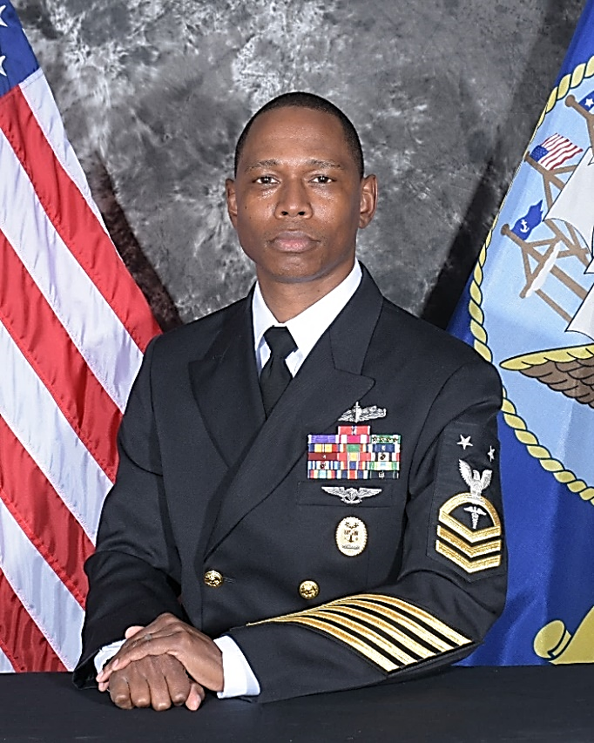
Leadership Triad
CAPT Tracy Isaac
Nurse Corps
Executive Officer
CAPT Kimberly Toone
Medical Corps
Commanding Officer
HMCM (SW/AW) CJ Eison
Command Master Chief

Slide 4

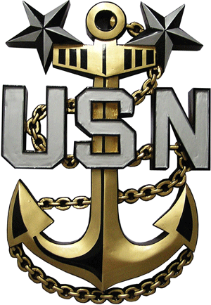


COMMANDING OFFICER
COMMAND MASTER CHIEF
EXECUTIVE OFFICER
NMOTC HEADQUARTERS
Director for Administration (DFA)
Director of Training (DOT)/ Chief Nursing Officer (CNO)
Director for Resource Management (DRM)
Director of Operations (DOO)
Director for Trauma Programs (DTP)
Pensacola, FL
Officer in Charge
NAVAL EXPEDITIONARY MEDICAL
TRAINING INSTITUTE (NEMTI)
Camp Pendleton, CA
Officer in Charge
NAVAL SURVIVAL TRAINING INSTITUTE
(NSTI)
Pensacola, FL
Department Head
HM TRAUMA TRAINING &
TRAINING NAVY TRAUMA CENTER
Jacksonville, FL / Chicago, IL / Cleveland , OH / Raleigh, NC / Philadelphia, PA
Officer in Charge
NAVAL AEROSPACE MEDICAL INSTITUTE
(NAMI)
Pensacola, FL
Officer in Charge
SURFACE WARFARE MEDICAL INSTITUTE
(SWMI)
San Diego, CA
Officer in Charge
NAVAL UNDERSEA MEDICAL INSTITUTE
(NUMI)
Groton, CT
Officer in Charge
NAVAL SPECIAL OPERATIONS
MEDICAL INSTITUTE (NSOMI)
FT Bragg, NC

Slide 5
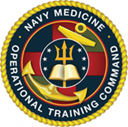
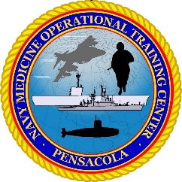
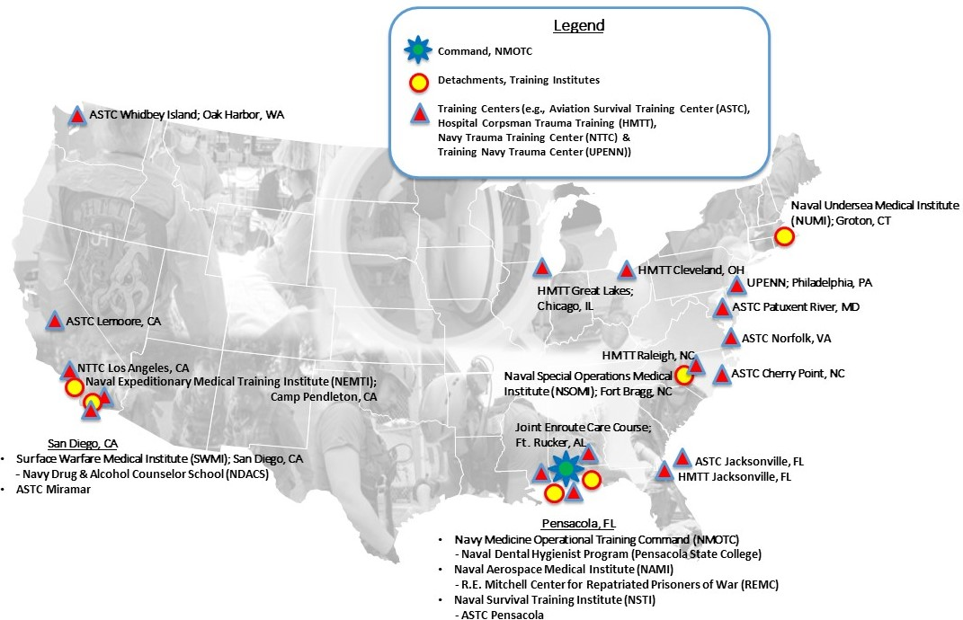
Notes:
Hospital Corpsman Trauma Training (HMTT).
Naval Dental Hygienist has a second school in Fayetteville, NC.
Course will close after this class and only be taught at Pensacola, FL campus.

Slide 6
NMOTC BY THE NUMBERS
OVERVIEW
FY-21 IMPACT
103 Facilities with 761 authorized staff on 20 Navy and Marine Corps bases and Civilian Institutions.
66 Courses of Instruction
          - 15 accredited Programs
Hyperbaric Medicine
- "First and only US Navy Chamber accredited by UHMS“
Hospital Corpsman Trauma Training (HMTT) Program (4 Sites)
Training Navy Trauma Center – Philadelphia (UPENN)
DoD’s only Repatriated Prisoner of War Center
International students from over 24 countries
Quota manager for operational short courses
Dental Hygiene Program Management
14,391 Aviation Survival students
2,043 Operational Medicine students (incl HMTT)
29,237 Aeromedical Waivers
6,070 Aviation Selection Test Battery
10,418 Aeromedical Physicals/Consults
2,223 Chief of Naval Air Training (CNATRA) Flight Training exit surveys
1,127 Naval Aviation (NASC) Preflight Indoctrination (API) exit surveys
Notes:
66 Courses of instruction: 24 aviation survival, 42 operational medicine (includes HMTT)
Hyperbaric Medicine: Accreditation Undersea Hyperbaric Medicine Society / Joint Commission recognized
- Quota Manager for Operational Short Courses C4, CWM, MM, FMCBC, MMCBC 3
- Recognized Aeromedical Examinations Directorate by National Association of Occupational Health Professionals

Slide 7
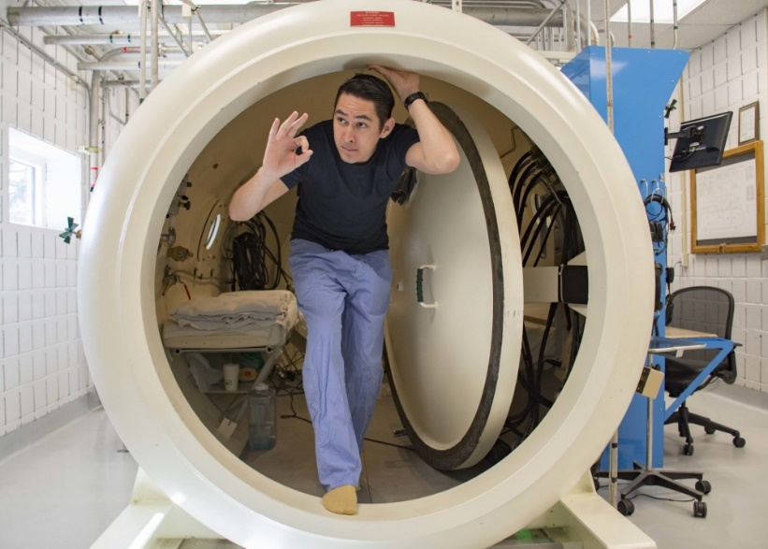
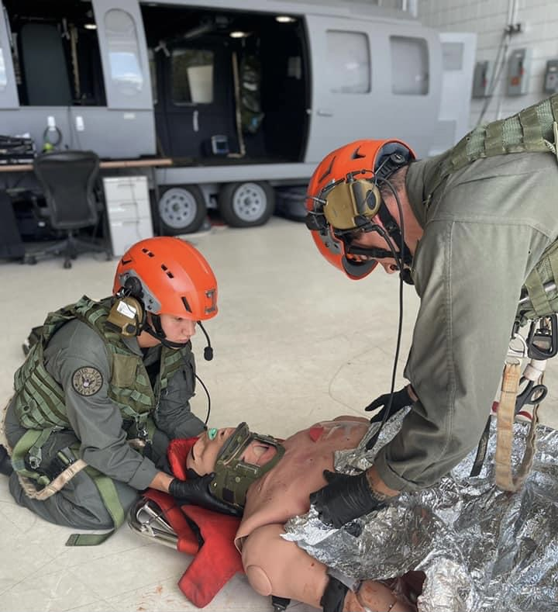
Naval Aerospace Medical Institute (NAMI)
Mission: Train aeromedical personnel for operational assignment and requirements. Develop, validate, apply and administer aeromedical standards for Naval Aviation. Provide aeromedical technical, professional and consultative support services and operational support for high-risk training in the Pensacola AOR via recompression chamber watch.
Location: Pensacola, FL

Slide 8
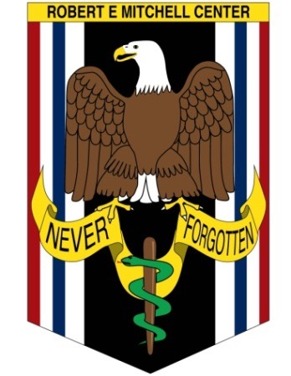
Robert E. Mitchell Center (REMC) for Repatriated Prisoner of War (RPOW) Studies
Mission: The Mitchell Center provides annual clinical evaluations and conducts follow up studies of RPOWs from Vietnam, Desert Storm and Operation Iraqi Freedom, in order to evaluate the mental and physical effects of captivity and delineate the predictors of repatriate resilience.
Location: Pensacola, FL
Previously performing over 200 RPOW evaluations annually (in-person evaluations paused for COVID precautions, with recent return to in-person evaluation). RPOWS from all services (and State Department) eligible.
Congressional seed funding provided in 1995 to establish REMC as a RPOW research center, the Program of which is executed per DoDI 3002.03.
Singularly holds all longitudinal data, starting in 1973, for tri-service RPOW physical and psychological evaluations (48 years).
Funding required for digitization of medical and archival data to ensure policy compliance (OMB, M-19-21, Transition to Electronic Record) and development of database for robust research efforts.

Slide 9
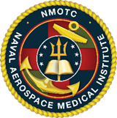
Naval Aerospace Medical Institute (NAMI)
Courses of Instruction:
SAR Medical Tech/L00A
Aerospace Medicine Technician/L04A
Aerospace Physiology Technician/L07A
Courses of Instruction:
1. Aerospace Medical Officer
- Aerospace Medicine Flight Surgeon
- Aerospace Operational Physiologist
- Aerospace Experimental Psychologist
- Aerospace Optometrist
- Aeromedical Physician Assistant
- Naval Aviation Medical Examiner
2. Residency in Aerospace Medicine
3. Flight Surgeon Refresher Training
4. Flight Medic Course
5. Joint Enroute Critical Care (Ft. Rucker)
Authorized Manning: 122 Onboard 114
Includes Ft Rucker (JECC) & Wright Pat (Air Force School of Aerospace Medicine)
Notes:
*Notes from NAMI 07DEC2021: 122 accounts for AMD manning with new protocol of RAMs counted as staff. We have 114 onboard, missing (1) FS/Clinical Psychiatrist (per AMD, though SL/detailer not tracking gap on their side); (2) Aerospace Experimental Psychologist; (1) Aeromedical Physician Assistant; (2) SAR Med Techs; (1) Dive Med Tech; and (1) Instructional Systems Specialist.*
NSTI: 12. Aerospace Physiologist Internship Program
1. SAR Medical L00A
Aerospace Medicine Technician (NEC L04A)
Aerospace Physiology Technician (NEC L07A)
Aerospace Medical Officer
- Aerospace Medicine Flight Surgeon
- Aerospace Physiologist
- Aerospace Experimental Psychologist
- Aerospace Optometrist
- Aeromedical Physician Assistant
- Naval Aviation Medical Examiner
2. Residency in Aerospace Medicine
3. Flight Surgeon Refresher Training
4. Flight Medic Course
5. Joint Enroute Critical Care (Ft. Rucker)

Slide 10
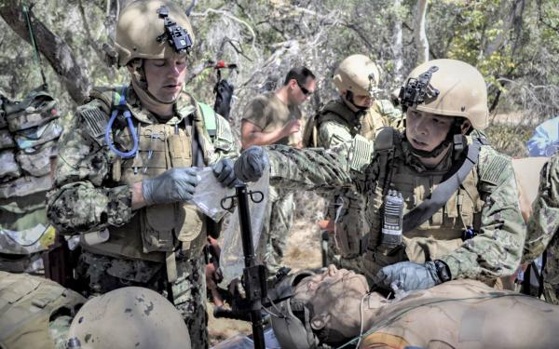
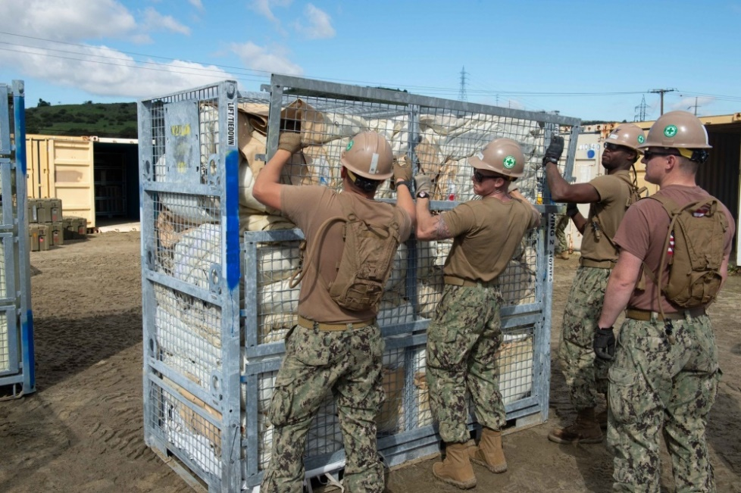
Naval Expeditionary Medical
Training Institute (NEMTI)
Mission: Navy Medicine's elite readiness training institute, for Expeditionary Medical Facilities, Expeditionary Resuscitative Surgical Systems, Tactical Combat Casualty Care, Marine Corps and Fleet Surgical Teams. Delivering advanced trauma training, ensuring readiness of medical personnel supporting the warfighter.
Locations: Camp Pendleton, CA and Los Angeles, CA

Slide 11
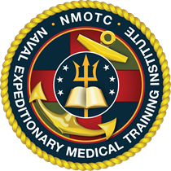
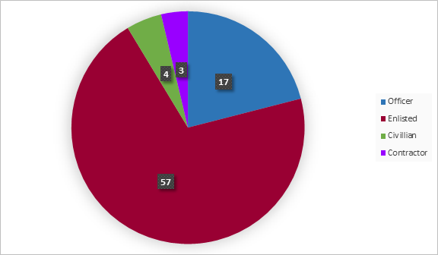
Naval Expeditionary Medical
Training Institute (NEMTI)
NEMTI Courses of Instruction:
1. Expeditionary Medical Facility training and ORE support
2. Expeditionary Resuscitative Surgical Systems (ERSS) course
3. Navy Trauma Training Center clinical course
4. Tactical Combat Casuality Care (TCCC) program Manager for BSO-18
6. Preventive Medicine FDPMU support
Navy Trauma Training Center Courses of Instruction:
1. Advanced Surgical Skills for Exposure in Trauma (ASSET)
2. Israeli Defense Force surgical training conducted at NTTC
Training team augments LA County+USC staff in the care of critically ill/injured patients when off student rotations.
Authorized Manning: 80
Onboard: 81

Slide 12
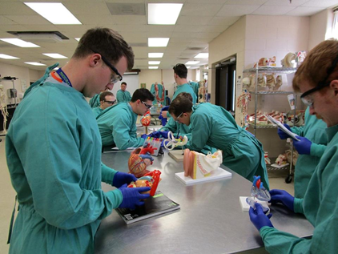
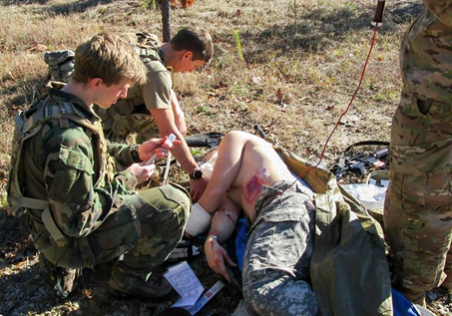
Naval Special Operations
Medical Institute (NSOMI)
Mission: Educate and train the full spectrum of United States Special Operations Command (USSOCOM) combat medics through superior teaching and instruction based on educational goals and curriculum development that is synchronized with the requirements of the force
Locations: Fort Bragg, NC

Slide 13
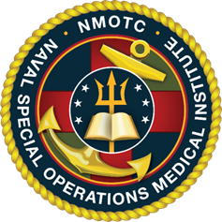
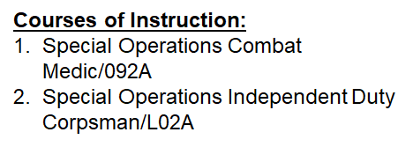
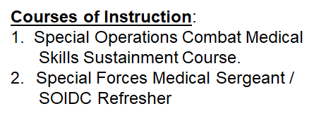
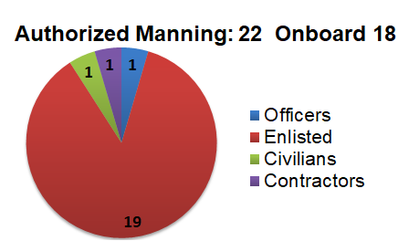
Naval Special Operations
Medical Institute (NSOMI)

Slide 14
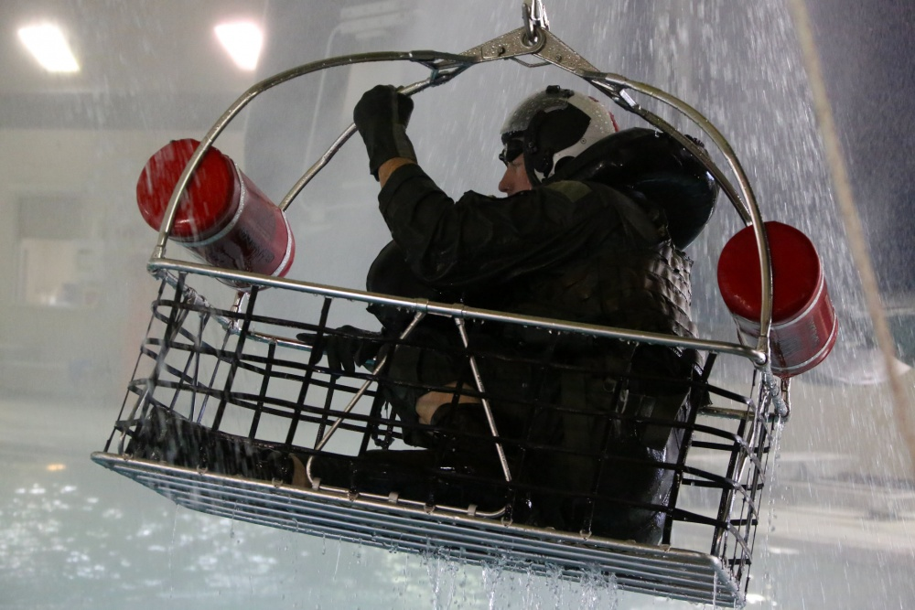
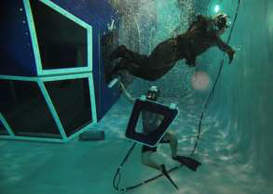
Naval Survival Training Institute
(NSTI)
Mission: To provide safe, effective, and relevant aviation survival and human performance training as the execution arm of the Chief of Naval Operations-mandated Naval Aviation Survival Training Program.
Locations: Patuxent River, MD; Norfolk, VA; Cherry Point, NC; Jacksonville, FL;
Pensacola, FL; Miramar, CA; Lemoore, CA; Whidbey Island, WA

Slide 15
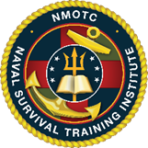
Naval Survival Training Institute (NSTI)
NEC Courses of Instruction:
1. Naval Aviation Water Survival Instructor
(NAWSTI-NEC 806A)
Courses of Instruction:
1. Aircrew Refresher NASTP Training x4
2. Aircrew Initial NASTP Training x4
3. Non-aircrew NASTP Training x4
4. Non-aircraft Specific NASTP Training x7
5. Naval Aerospace Operational
Physiologist Internship Program
6. NAWSTI – NEC 806A
Authorized Manning: 278 Onboard 261
Notes:
5. Naval Aviation Water Survival Instructor
(NAWSTI-NEC 806A)
6. L07A Internship Program

Slide 16
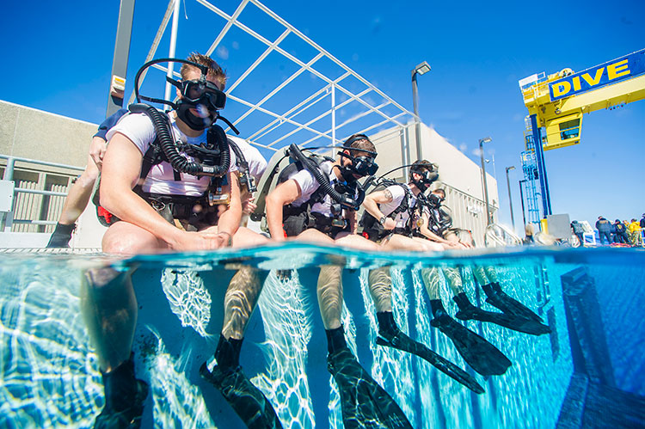
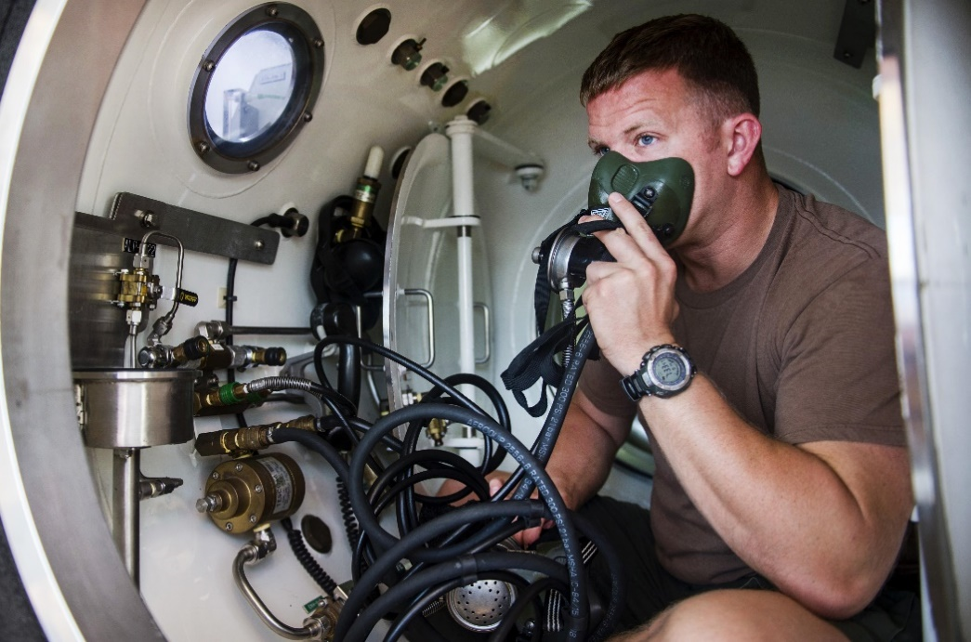
Naval Undersea Medical Institute
(NUMI)
Mission: Training detachment for Undersea Medical Officers, Radiation Health Officers, Radiation Health Technicians, Submarine Force Independent Duty Corpsman, Radiation Health Indoctrination, Submarine Force Independent Duty Corpsman Refresher Training and Undersea Medical Officer Refresher Training.
Location: Groton, CT

Slide 17
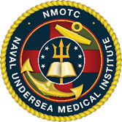
Naval Undersea Medical Institute (NUMI)
Courses of Instruction:
Submarine Force IDC/HM-L01A
Radiation Health Tech/HM-L05A
IDC Common Curricula HM-L10A
Courses of Instruction:
Undersea Medical Officer
Radiation Health Officer
Radiation Health Indoc Course
IDC Refresher Training
5. UMO Refresher Training
Authorized Manning: 34 Onboard 30

Slide 18
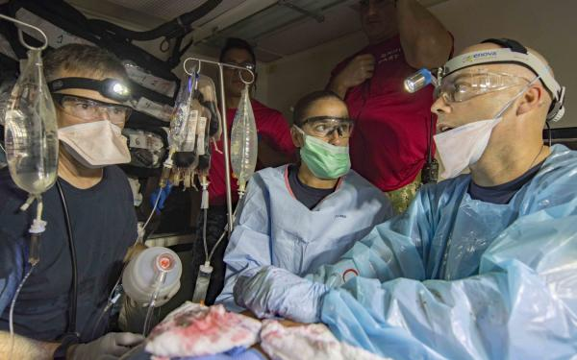
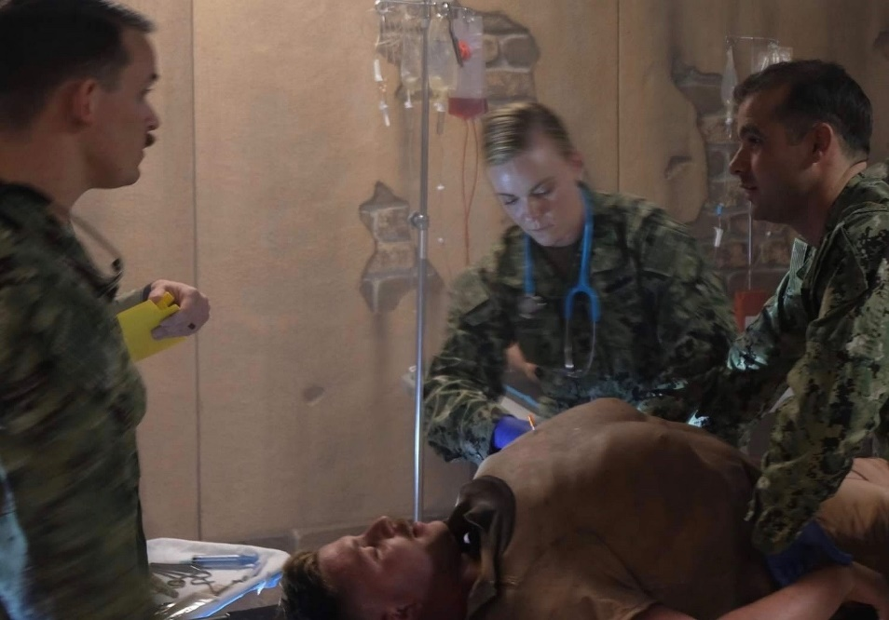
Surface Warfare Medical Institute
(SWMI)
Mission: Support the Department of Defense by developing Navy healthcare professionals with the Character, Competence, and Connections required for global assignments in a variety of operational platforms.
Location: San Diego, CA
Notes:
Change photo on bottom left.

Slide 19
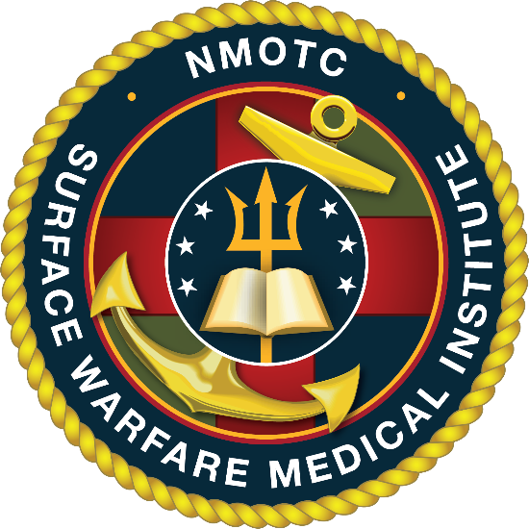
Surface Warfare Medical Institute (SWMI)
Courses of Instruction:
•Surface Force Independent Duty Corpsman (SF/Dive IDC-L10A)
•Dive Independent Duty Corpsman (SF/Dive IDC-L28A)
•SF-IDC Refresher Training (REFTRA)
•Navy Drug and Alcohol Counselor School (NDAC/Intern-700D)
•Inter-service Physician Assistant, Phase II (IPAP)
Fleet Support Courses:
•Surface Force Medical Indoctrination Course (SFMIC)
•Surface Warfare Medical Officer Indoc Course (SWMOIC)
•Surface Warfare Medical Depart Officer Indoc Course (SWMDOIC)
•Medical Regulating (MEDREG)
•Dental Operational Force Management Training Course (DOFMT)
•Commander Amphibious Task Force Surgeon (CATF Surgeon)
Authorized Manning: 88 Onboard 82

Slide 20
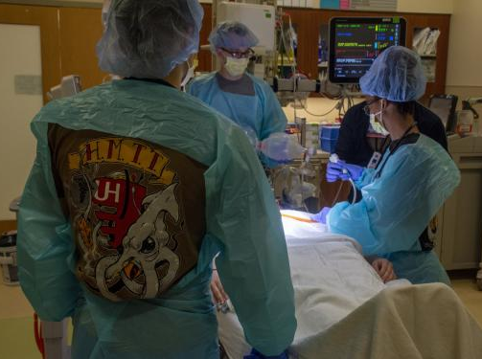
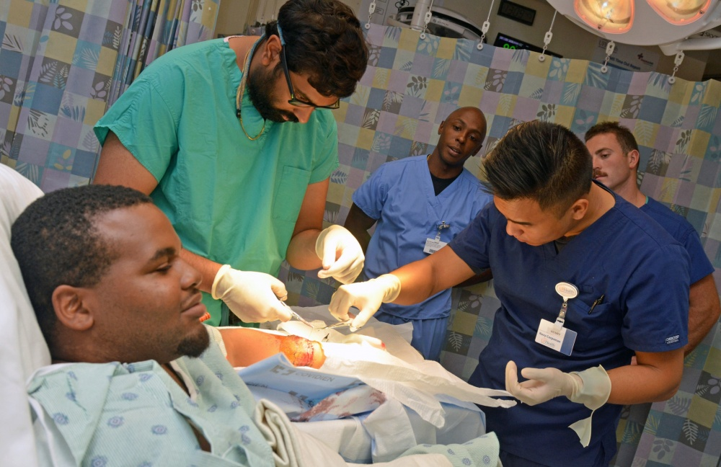
Hospital Corpsman Trauma Training (HMTT) /
Training Navy Trauma Center Philadelphia (UPENN)
Mission: To provide enhanced, real-world trauma experience for Navy hospital corpsmen, who provide advanced life-saving care to Sailors and Marines in the field through innovative partnerships with private-sector health systems.
Locations: Chicago, IL; Cleveland, OH; Jacksonville, FL; Raleigh, NC; Philadelphia, PA
Notes:
Authorized 33
Onboard 25 (to include 2 Reservist)

Slide 21
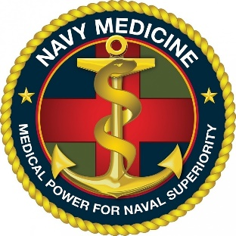
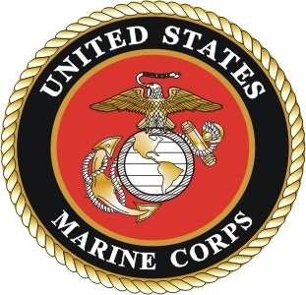
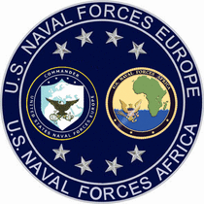

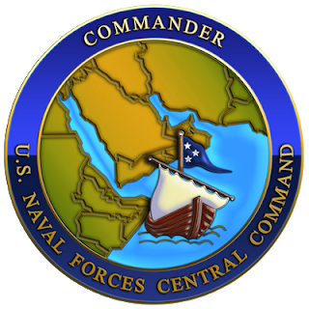
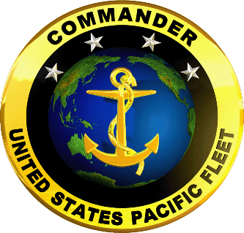
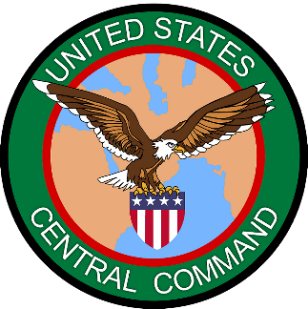
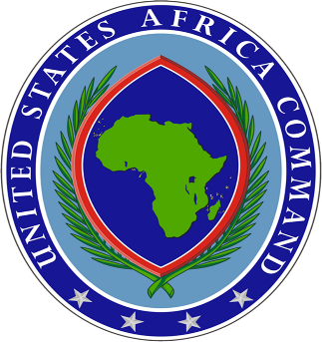
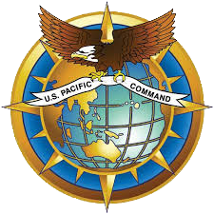
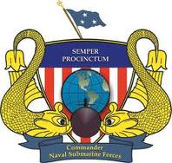
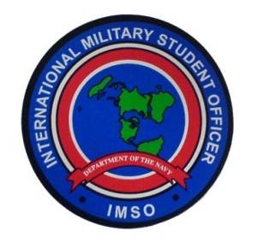
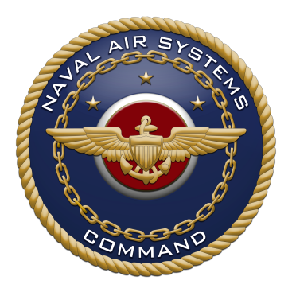
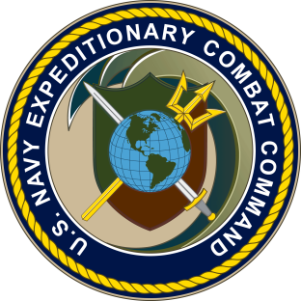
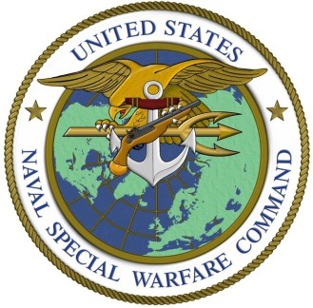
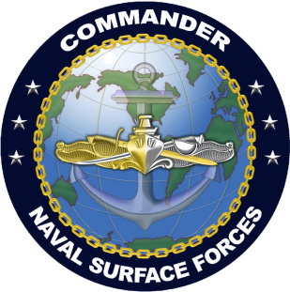
Customers

Slide 22
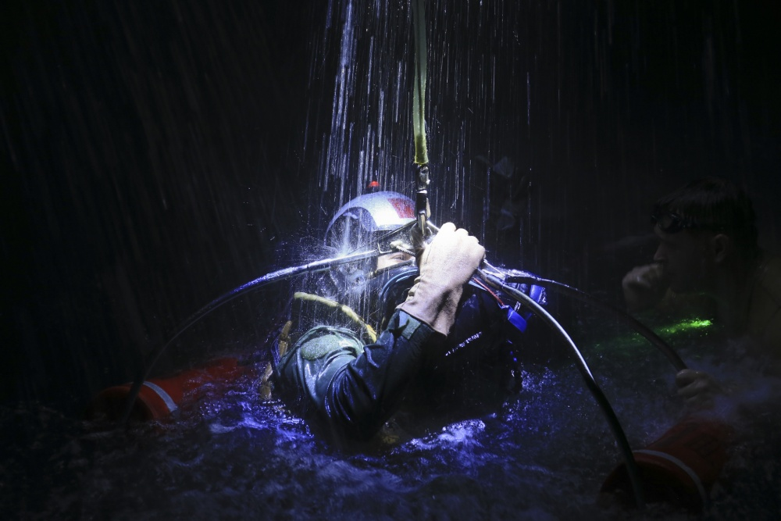
Questions?

